Slide 1
Intellectual Property Rights (IPRs)

Slide 2

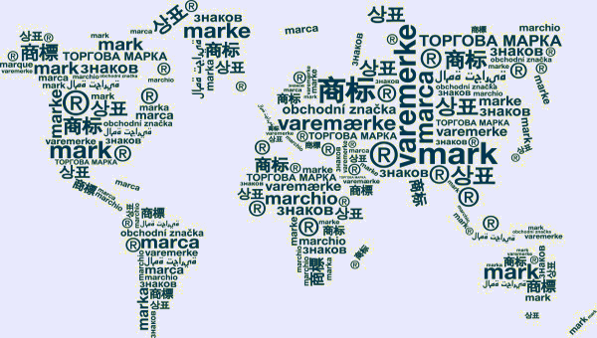

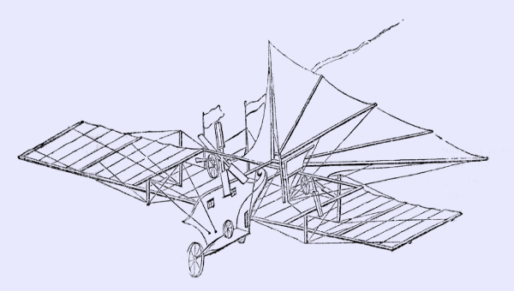
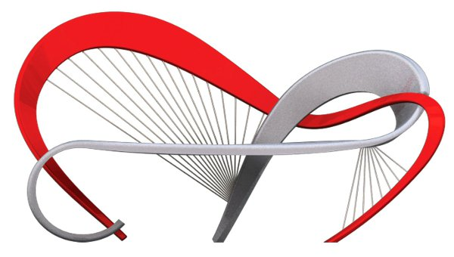

IPR
Intellectual Property Rights (IPRs) are legal rights that protect creations and/or inventions resulting from intellectual activity in the industrial, scientific, literary or artistic fields.
The most common IPRs include:
Copyright
Trademarks
Geographical indications
Patents
Industrial designs
Trade secrets

Slide 3
What Are Some Examples of Violations of Intellectual Property?
The significant violations of intellectual property consist of infringement, counterfeiting, and misappropriation of trade secrets. Violations of intellectual property include:
Creating a logo or name meant to confuse buyers into thinking they’re buying the original brand
Recording video or music without authorization or copying copyrighted materials (yes, even on a photocopier, for private use)
Copying another person’s patent and marketing it as a new patent
Manufacturing patented goods without a license to do so
Since intellectual property can be bought, sold, or leased out, it offers many protections equal to real property ownership. Likewise, similar remedies exist.
A dispute may end with property confiscation, an order of monetary damages, or cease and desist orders.

Slide 4

Copyright and rights related to copyright.
The rights of authors of literary and artistic works (such as books and other writings, musical compositions, paintings, Sculpture, computer programs and films) are protected by copyright, for a minimum period of 50 years after the death of the author.
Also protected through copyright and related (sometimes referred to as “neighbouring”) rights are the rights of performers (e.g. actors, singers and musicians), producers of phonograms (sound recordings) and broadcasting organizations.
The main social purpose of protection of copyright and related rights is to encourage and reward creative work.

Slide 5

Copyright and rights related to copyright
Works commonly protected by copyright throughout the world include:
literary works such as novels, poems, plays, reference works, newspaper articles;
computer programs, databases;
films, musical compositions, and choreography;
artistic works such as paintings, drawings, photographs, and sculpture;
architecture; and
advertisements, maps, and technical drawings.
Copyright protection extends only to expressions, and not to ideas, procedures, methods of operation or mathematical concepts as such.
Copyright may or may not be available for a number of objects such as titles, slogans, or logos, depending on whether they contain sufficient authorship.

Slide 6
Copyright and rights related to copyright
There are two types of rights under copyright:
Economic rights, which allow the rights owner to derive financial reward from the use of their works by others; and
Moral rights, which protect the non-economic interests of the author.
Most copyright laws state that the rights owner has the economic right to authorize or prevent certain uses in relation to a work or, in some cases, to receive remuneration for the use of their work. The economic rights owner of a work can prohibit or authorize:
its reproduction in various forms, such as printed publication or sound recording;
its public performance, such as in a play or musical work;
its recording, for example, in the form of compact discs or DVDs;
its broadcasting, by radio, cable or satellite;
its translation into other languages; and
its adaptation, such as a novel into a film screenplay.
Examples of widely recognized moral rights include the right to claim authorship of a work and the right to oppose changes to a work that could harm the creator's reputation.

Slide 7
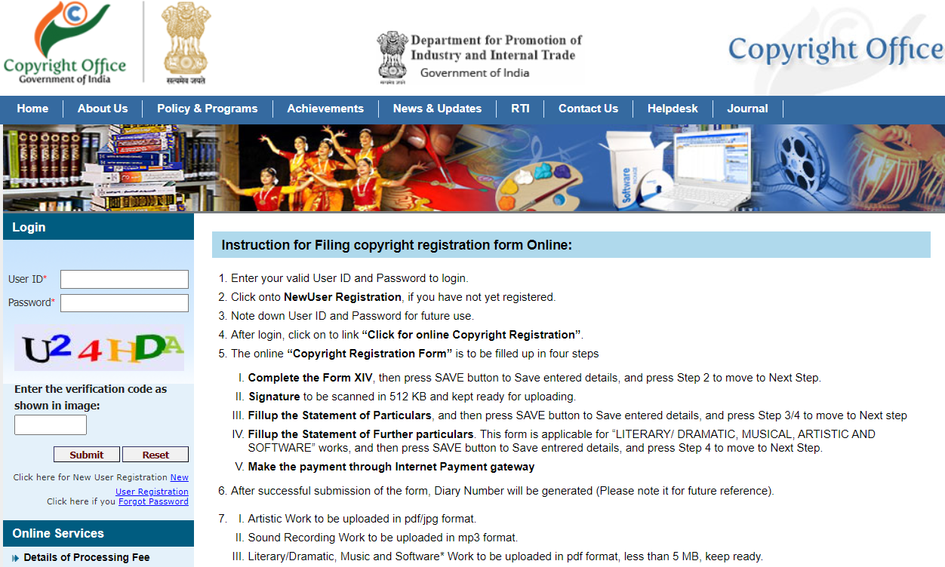
Copyright Registration in India
https://copyright.gov.in/UserRegistration/frmLoginPage.aspx

Slide 8

Trademarks
A trademark is a sign capable of distinguishing the goods or services of one enterprise from those of other enterprises.
Trademarks protect logos, sounds, words, colors, or symbols used by a company to distinguish its service or product. Trademark examples include the Twitter logo, McDonald’s golden arches, and the font used by Dunkin.
Although patents protect one product, trademarks may cover a group of products. The Lanham Act, also called the Trademark Act of 1946, governs trademarks, infringement, and service marks.

Slide 9
Trademarks
How long does trademark protection last?
The term of trademark registration can vary, but is usually ten years.
It can be renewed indefinitely on payment of additional fees.
Trademark rights are private rights and protection is enforced through court orders.
What kinds of trademark can be registered?
A word or a combination of words, letters, and numerals can perfectly constitute a trademark.
But trademarks may also consist of drawings, symbols, three-dimensional features such as the shape and packaging of goods, non-visible signs such as sounds or fragrances, or color shades used as distinguishing features – the possibilities are almost limitless.

Slide 10
Trademarks
What rights does trademark registration provide?
In principle, a trademark registration will confer an exclusive right to the use of the registered trademark.
This implies that the trademark can be exclusively used by its owner, or licensed to another party for use in return for payment.
Registration provides legal certainty and reinforces the position of the right holder, for example, in case of litigation.
How can I protect my trademark?
At the national/regional level, trademark protection can be obtained through registration, by filing an application for registration with the national/regional trademark office and paying the required fees.
At the international level, you have two options: either you can file a trademark application with the trademark office of each country in which you are seeking protection, or you can use WIPO’s Madrid System.

Slide 11
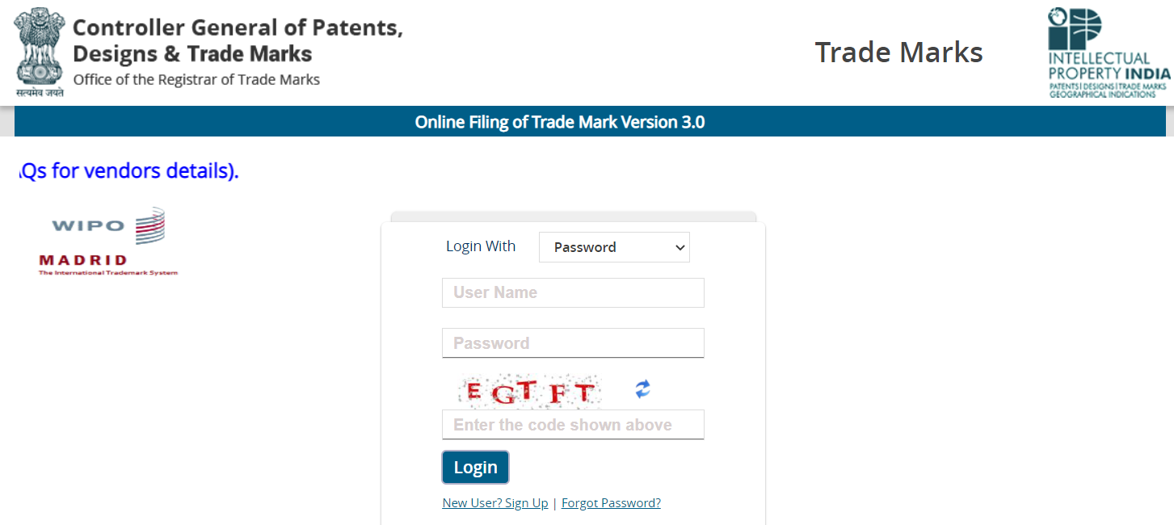
Trademarks Registration in India
https://ipindiaonline.gov.in/trademarkefiling/user/frmloginnew.aspx

Slide 12

Patent
A patent is an exclusive right granted for an invention, which is a product or a process that provides, in general, a new way of doing something, or offers a new technical solution to a problem.
A patent is a government-granted monopoly to build, sell, and use your invention (and prevent others from doing so).
To get a patent, technical information about the invention must be disclosed to the public in a patent application.
What kind of protection does a patent offer?
In principle, the patent owner has the exclusive right to prevent or stop others from commercially exploiting the patented invention. In other words, patent protection means that the invention cannot be commercially made, used, distributed, imported or sold by others without the patent owner's consent.

Slide 13
Patent
Is a patent valid in every country?
Patents are territorial rights. In general, the exclusive rights are only applicable in the country or region in which a patent has been filed and granted, in accordance with the law of that country or region.
What kinds of inventions can be protected?
Patents may be granted for inventions in any field of technology, from an everyday kitchen utensil to a nanotechnology chip.
An invention can be a product – such as a chemical compound, or a process, for example – or a process for producing a specific chemical compound.
Many products in fact contain a number of inventions. For example, a laptop computer can involve hundreds of inventions, working together.

Slide 14
Patent
What conditions must be met to obtain patent protection?
There are numerous conditions that must be met in order to obtain a patent and it is not possible to compile an exhaustive, universally applicable list. However, some of the key conditions include the following:
The invention must show an element of novelty; that is, some new characteristic which is not known in the body of existing knowledge in its technical field. This body of existing knowledge is called “prior art”.
The invention must involve an “inventive step” or “non-obvious”, which means that it could not be obviously deduced by a person having ordinary skill in the relevant technical field.
The invention must be capable of industrial application, meaning that it must be capable of being used for an industrial or business purpose beyond a mere theoretical phenomenon, or be useful.
Its subject matter must be accepted as “patentable” under law. In many countries, scientific theories, aesthetic creations, mathematical methods, plant or animal varieties, discoveries of natural substances, commercial methods, methods for medical treatment (as opposed to medical products) or computer programs are generally not patentable.
The invention must be disclosed in an application in a manner sufficiently clear and complete to enable it to be replicated by a person with an ordinary level of skill in the relevant technical field.

Slide 15
Patent
If you are issued a patent, it’s usually good for 20 years; however, there are some patents that are only good for 14 years.
After 20 years, your patent expires and anyone can copy, build,and sell your invention. In exchange for the “monopoly,” you must disclose the details of your invention to the public so that someone “practiced in the arts” could recreate it.
To receive a patent your idea must meet four requirements:
The subject matter must be “patentable” (as defined by Congress and the courts).
Your idea must be “new.”
The idea must be “useful.”
Your idea must be “non-obvious.”

Slide 16
Patent
There are three types of patents you can file for:
Utility patent – Utility patents may be granted to anyone who invents or discovers any new and useful process, machine, article of manufacture, composition of matter, or any new and useful improvement thereof (good for 20 years).
Design patent – Design patents may be granted to anyone who invents a new, original, and ornamental design (good for 14 years).
Plant patent – Plant patents may be granted to anyone who invents or discovers and asexually reproduces any distinct and new variety of plant (good for 20 years).

Slide 17
Patent filling in India
What types of inventions are not patentable in India?
1) an invention which is frivolous or which claims anything obviously contrary to well established natural laws;
2) an invention the primary or intended use or commercial exploitation of which could be contrary to public order or morality or which causes serious prejudice to human , animal or plant life or health or to the environment;
3) the mere discovery of scientific principle or the formulation of an abstract theory or discovery of any living thing or non-living substance occurring in nature;
4) the mere discovery of a new form of a known substance which does not result in enhancement of the known efficacy of that substance or the mere discovery of any new property or new use for a known substance or of the mere use of a known process, machine or apparatus unless such known process results in a new product or employs at least one new reactant

Slide 18
Patent filling in India
What types of inventions are not patentable in India?
5) a substance obtained by mere admixture resulting only in the aggregation of the properties of the components thereof or a process for producing such substance;
6) the mere arrangement or re-arrangement or duplication of known devices each functioning independently of one another in a known way;
7) a method of agriculture or horticulture;
8) any process for medicinal, surgical, curative, prophylactic (diagnostic, therapeutic) or other treatment of human beings or any process for a similar treatment of animals to render them free of disease or to increase their economic value or that of their products;
9) plants and animals in whole or any part thereof other than microorganisms but including seeds, varieties and species and essentially biological processes for production or propagation of plants and animals;

Slide 19
Patent filling in India
What types of inventions are not patentable in India?
10) a mathematical or business method or a computer program per se or algorithms;
11) a literary, dramatic, musical or artistic work or any other aesthetic creation whatsoever including cinematographic works and television productions;
12) a mere scheme or rule or method of performing mental act or method of playing game;
13) a presentation of information;
14) topography of integrated circuits;
15) an invention which, in effect, is traditional knowledge or which is an aggregation or duplication of known properties of traditionally known component or components; 16) inventions relating to atomic energy;

Slide 20
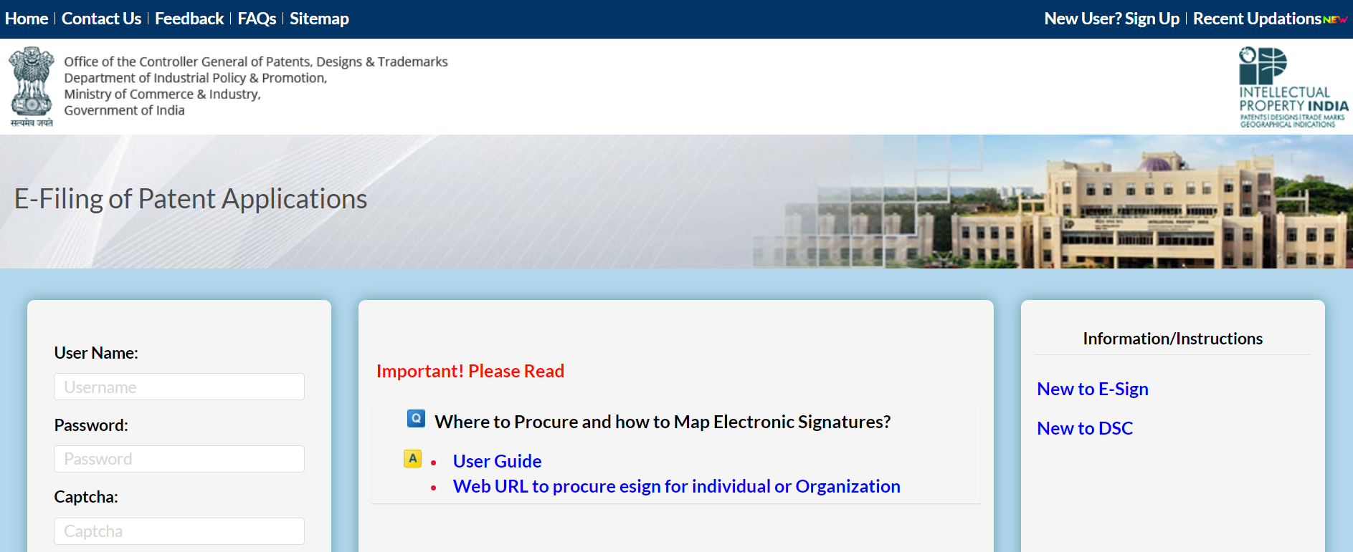
Patent filling in India
https://ipindiaonline.gov.in/epatentfiling/goForLogin/doLogin

Slide 21

Geographical Indications
A geographical indication (GI) is a sign used on products that have a specific geographical origin and possess qualities or a reputation that are due to that origin.
In order to function as a GI, a sign must identify a product as originating in a given place.
In addition, the qualities, characteristics or reputation of the product should be essentially due to the place of origin.
Since the qualities depend on the geographical place of production, there is a clear link between the product and its original place of production.

Slide 22
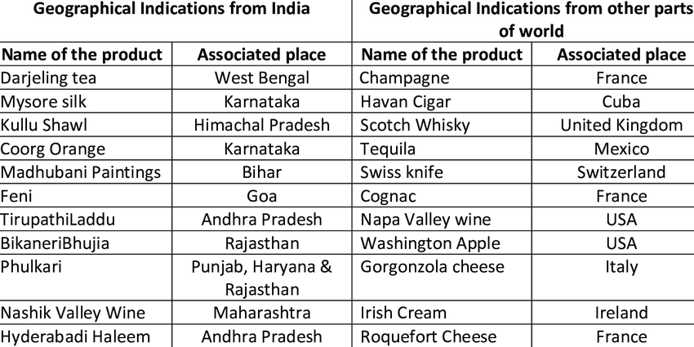
Geographical Indications
Geographical indications are typically used for agricultural products, foodstuffs, wine and spirit drinks, handicrafts, and industrial products.

Slide 23
Geographical Indications
What rights does a geographical indication provide?
A geographical indication right enables those who have the right to use the indication to prevent its use by a third party whose product does not conform to the applicable standards.
For example, in the jurisdictions in which the Darjeeling geographical indication is protected, producers of Darjeeling tea can exclude use of the term “Darjeeling” for tea not grown in their tea gardens or not produced according to the standards set out in the code of practice for the geographical indication.
However, a protected geographical indication does not enable the holder to prevent someone from making a product using the same techniques as those set out in the standards for that indication.
Protection for a geographical indication is usually obtained by acquiring a right over the sign that constitutes the indication.

Slide 24
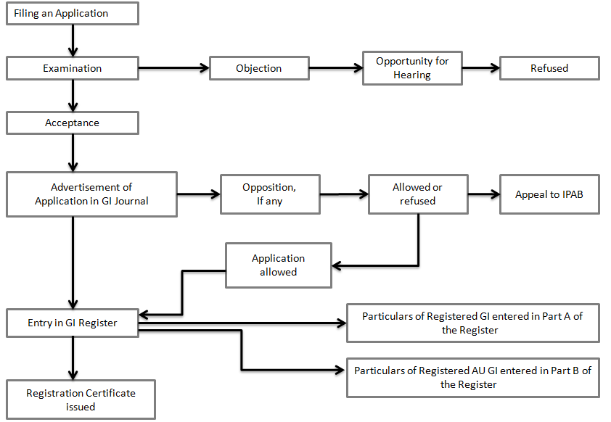
Geographical Indications

Slide 25
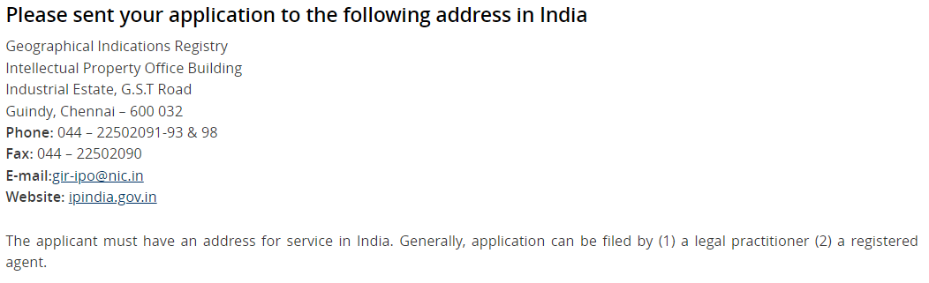
Geographical Indications Registration in India
https://ipindia.gov.in/the-registration-process-gi.htm

Slide 26

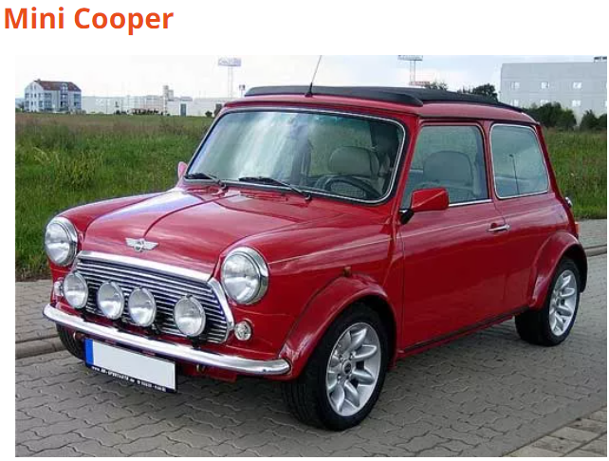
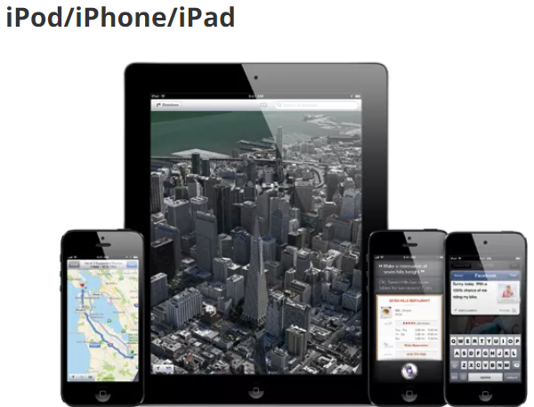
Industrial Designs
In a legal sense, an industrial design constitutes the ornamental aspect of an article.
An industrial design may consist of three dimensional features, such as the shape of an article, or two dimensional features, such as patterns, lines or color.
In principle, the owner of a registered industrial design or of a design patent has the right to prevent third parties from making, selling or importing articles bearing or embodying a design which is a copy, or substantially a copy, of the protected design, when such acts are undertaken for commercial purposes.

Slide 27
Industrial Designs
Industrial designs are applied to a wide variety of products of industry and handicraft items: from packages and containers to furnishing and household goods, from lighting equipment to jewelry, and from electronic devices to textiles. Industrial designs may also be relevant to graphic symbols, graphical user interfaces (GUI), and logos.
In most countries, an industrial design needs to be registered in order to be protected under industrial design law as a “registered design”. In some countries, industrial designs are protected under patent law as “design patents ”.
Industrial design laws in some countries grant – without registration – time- and scope limited protection to so-called “unregistered industrial designs”.
Depending on the particular national law and the kind of design, industrial designs may also be protected as works of art under copyright law.

Slide 28
Industrial Designs
Industrial design rights are granted for a limited period. The duration of the protection of industrial designs varies from country to country, but it amounts at least to 10 years. In many countries, the total duration of protection is divided into successive renewable periods.
Industrial design rights are usually enforced in a court, generally on the initiative of the owner of the rights, as provided for by the applicable law. The remedies and penalties vary from country to country and could be civil (injunctions to desist from an infringement, payment of damages, etc.), criminal or administrative.

Slide 29

Trade secrets
Trade secrets are IP rights on confidential information which may be sold or licensed.
In general, any confidential business information which provides an enterprise a competitive edge and is unknown to others may be protected as a trade secret.
The unauthorized acquisition, use or disclosure of such secret information in a manner contrary to honest commercial practices by others is regarded as an unfair practice and a violation of the trade secret protection.

Slide 30
Trade secrets
In general, to qualify as a trade secret, the information must be:
commercially valuable because it is secret,
be known only to a limited group of persons, and
be subject to reasonable steps taken by the rightful holder of the information to keep it secret, including the use of confidentiality agreements for business partners and employees.
The unauthorized acquisition, use or disclosure of such secret information in a manner contrary to honest commercial practices by others is regarded as an unfair practice and a violation of the trade secret protection.

Slide 31
Trade secrets
What kind of protection does a trade secret offer?
Depending on the legal system, the legal protection of business secrets forms part of the general concept of protection against unfair competition or is based on specific provisions or case law on the protection of confidential information.
While a final determination of whether trade secret protection is violated or not depends on the circumstances of each individual case, in general, unfair practices in respect of secret information include industrial or commercial espionage, breach of contract and breach of confidence.
A trade secret owner, however, cannot stop others from using the same technical or commercial information, if they acquired or developed such information independently by themselves through their own R&D, reverse engineering or marketing analysis, etc. Since trade secrets are not made public, unlike patents, they do not provide “defensive” protection, as being prior art. For example, if a specific process of producing Compound X has been protected by a trade secret, someone else can obtain a patent or a utility model on the same invention, if the inventor arrived at that invention independently.

Slide 32
Trade secrets
How can a trade secret be protected?
Companies should take preventive measures to protect trade secrets against theft or misappropriation, including:
Non-disclosure agreement (NDA): employees and business partners should sign a non-disclosure agreement that prevent them from disclosing a company’s confidential information.
Non-compete agreement (NCA): employers should ask employees, contractors and consultants to sign a non-compete agreement to prevent them from entering in competition when their employment/service agreement ends.
Robust IT security infrastructure
Controlling the accessibility of important documents

Slide 33
Types of Trade secrets
Trade secrets encompass both technical information, such as information concerning manufacturing processes, pharmaceutical test data, designs and drawings of computer programs, and commercial information, such as distribution methods, list of suppliers and clients, and advertising strategies.
A trade secret may be also made up of a combination of elements, each of which by itself is in the public domain, but where the combination, which is kept secret, provides a competitive advantage.
Other examples of information that may be protected by trade secrets include financial information, formulas and recipes and source codes.

Slide 34
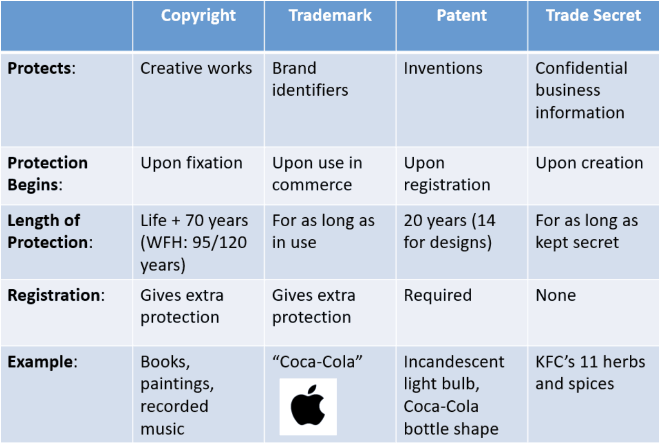
Trade secrets

